Slide 1

Automated Forecasting of Streamflow Conditions Using SAS®
Samuel T. Croker
Shane L. Hornibrook
Tomonori Ishikawa

Slide 2
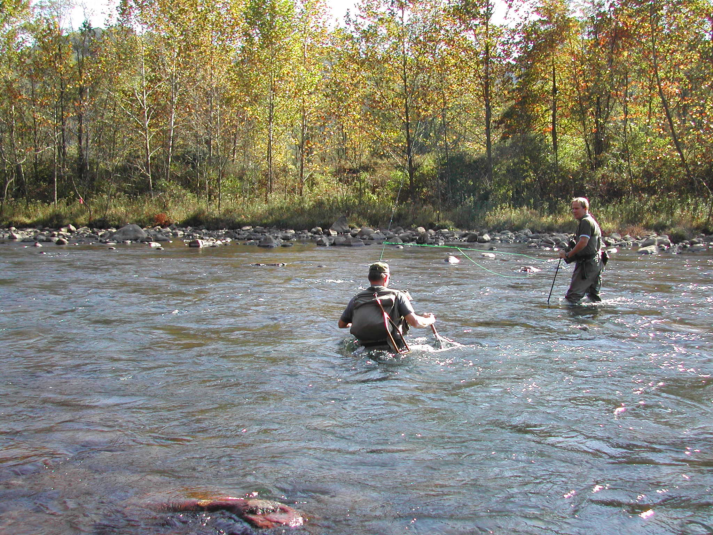
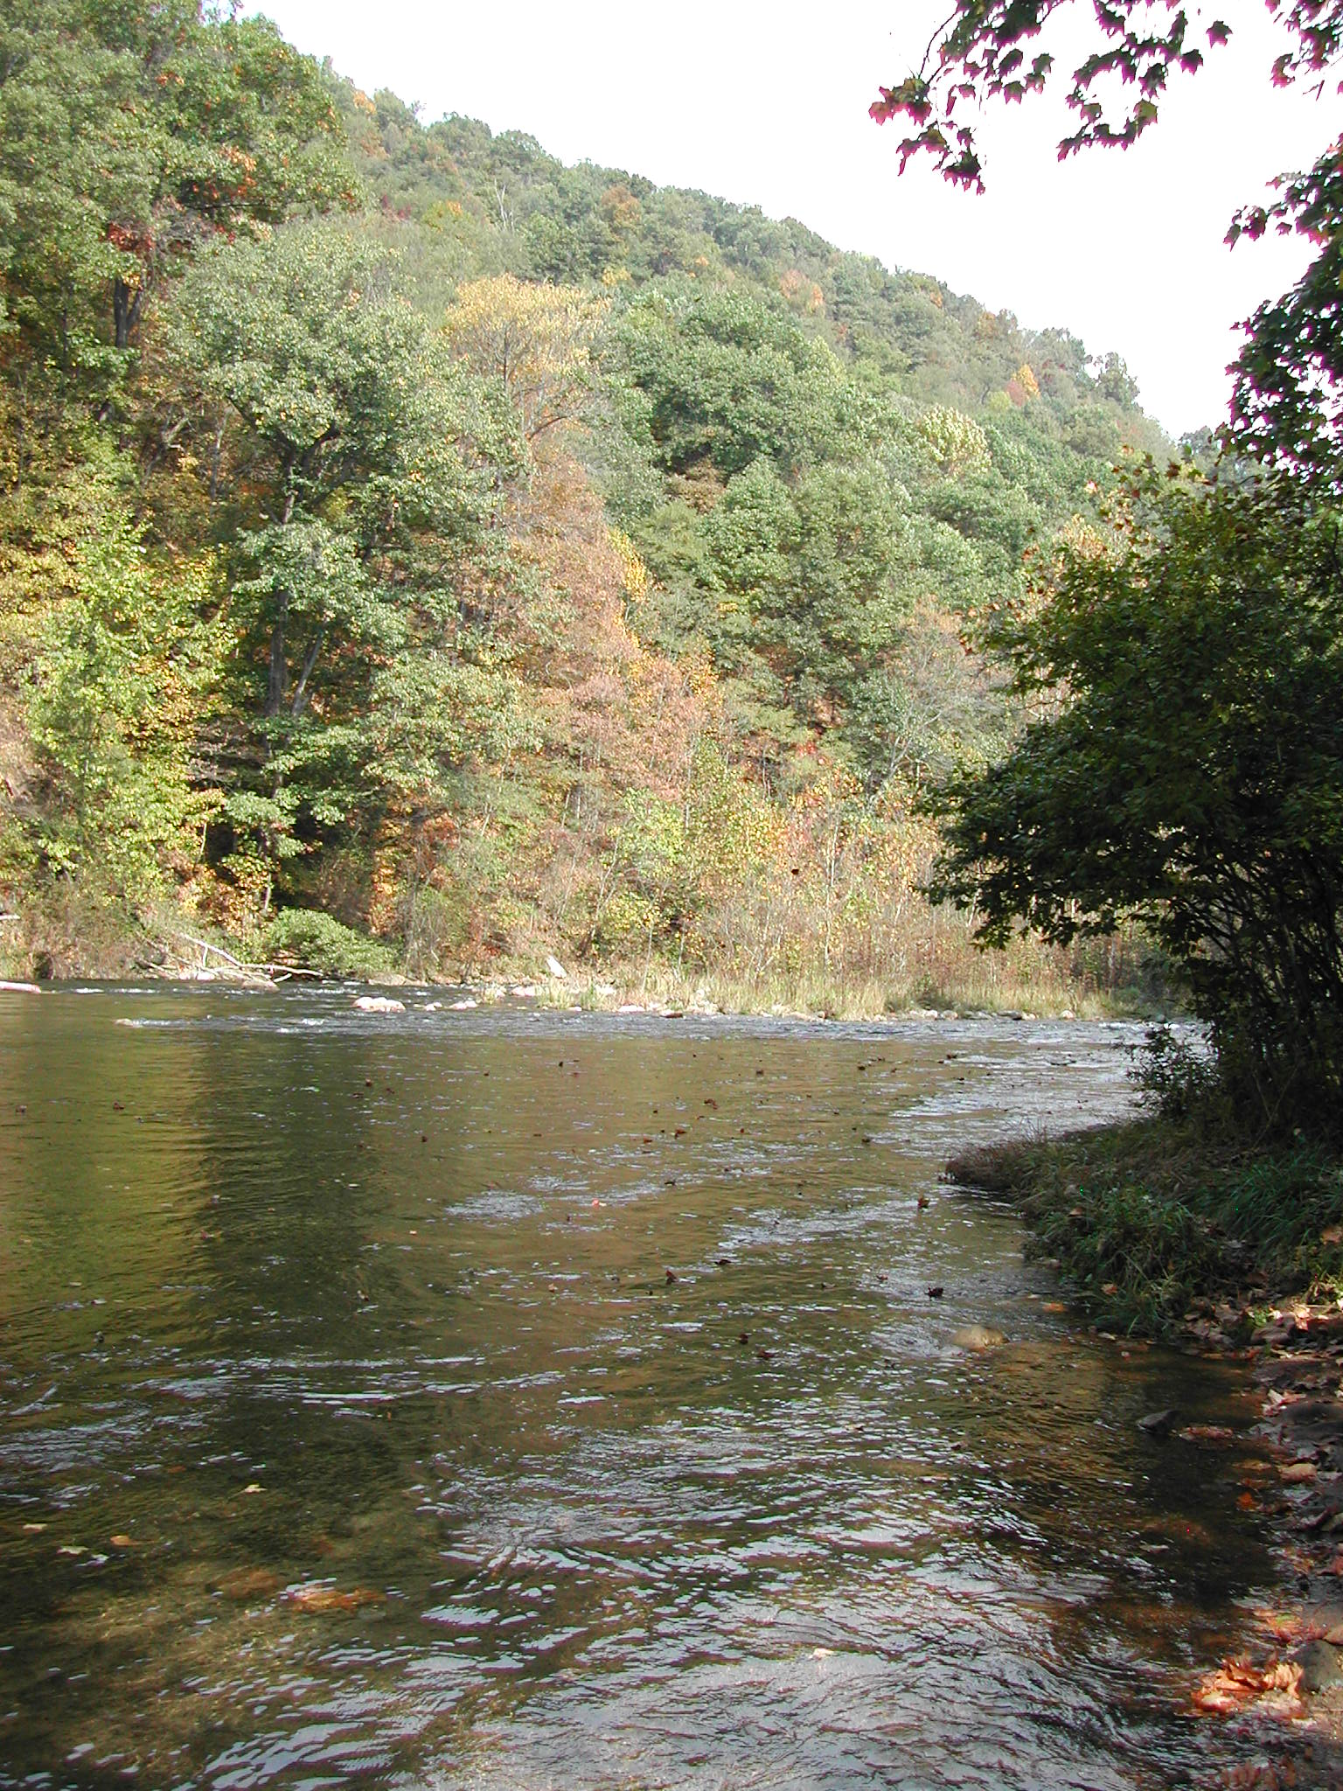
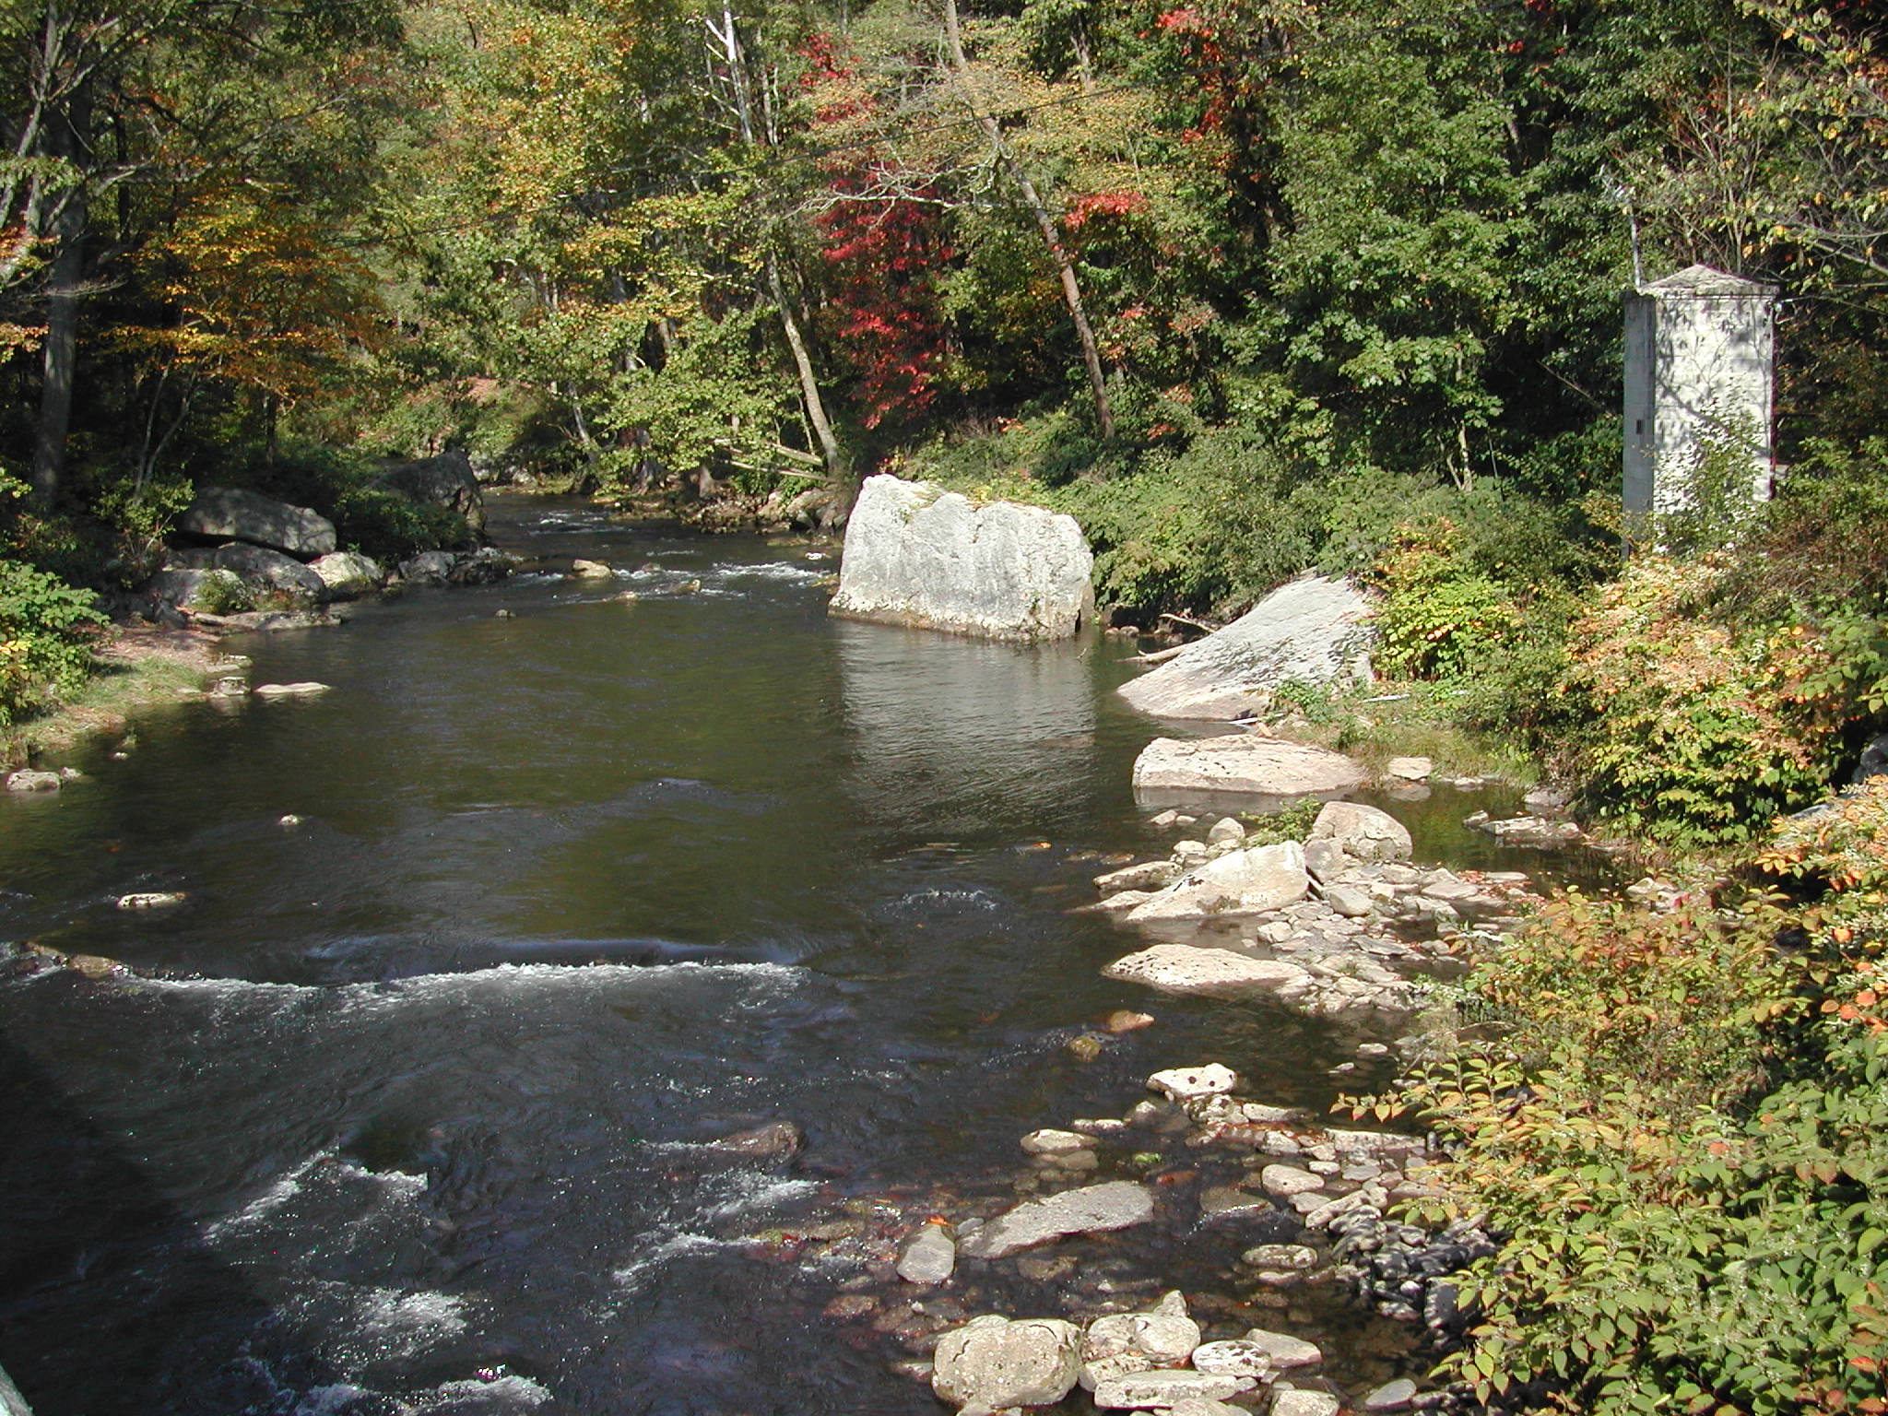
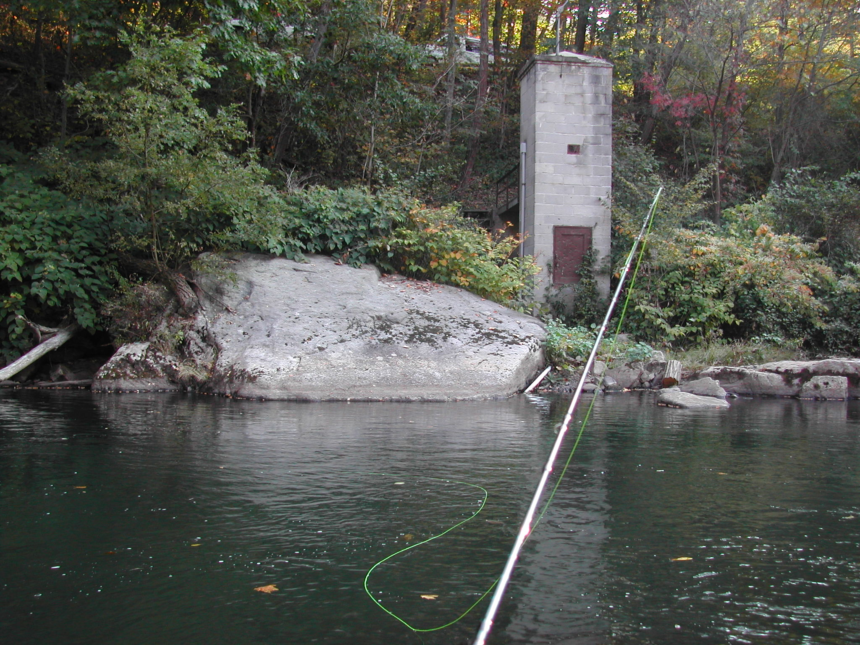
Notes:
See any fish? Neither did we that day… the PhD pool

Slide 3
Topics
Background
Attaining and Preparing Data
Forecasting
Visualizing
Notes:
More App than Data analysis

Slide 4
A Fishing Application
Retrieve Data
Prepare Data
Forecast
Display
Results

Slide 5
Attaining the Data
USGS National Water Information System
  http://waterdata.usgs.gov/nwis/rt

Slide 8
Data Collected
Discharge
  Measured ft³/s
  Less understandable
  …but more frequently used - it is the measurement that the dam people will tell you
Stage
  Measured ft above a datum point
  More easily understood and directly relatable
  I like it
Various other parameters
  http://nwis.waterdata.usgs.gov/usa/nwis/pmcodes?pm_group=Physical+Property&pm_search=&format=rdb&show=parameter_group_nm&show=parameter_nm

Slide 9
#
#
# USGS Parameter Code Definitions File
#
# Column Definitions
# parameter_cd - Parameter Code
# parameter_group_nm - Group Name
# parameter_nm - Parameter Name/Description
#
#
# Date Retrieved: 2007-11-11 10:32:39 EST
#
parameter_cd parameter_group_nm parameter_nm
5s 30s 170s
00003 Physical Property Sampling depth, feet
00004 Physical Property Stream width, feet
00010 Physical Property Temperature, water, degrees Celsius
00011 Physical Property Temperature, water, degrees Fahrenheit
00012 Physical Property Evaporation temperature, 48 inch pan, degrees Celsius
00013 Physical Property Evaporation temperature, 24 inch pan, degrees Celsius
00014 Physical Property Wet bulb temperature, degrees Celsius
00020 Physical Property Temperature, air, degrees Celsius
00021 Physical Property Temperature, air, degrees Fahrenheit
00024 Physical Property Sample length, inches
00025 Physical Property Barometric pressure, millimeters of mercury
00030 Physical Property Incident solar radiation intensity, calories per square centimeter per day
00031 Physical Property Incident light remaining at depth, percent
00032 Physical Property Cloud cover, percent
00034 Physical Property Depth to 1 percent of surface light, feet
00035 Physical Property Wind speed, miles per hour
00036 Physical Property Wind direction, degrees clockwise from true north
00042 Physical Property Altitude, feet above mean sea level
00045 Physical Property Precipitation, total, inches
00046 Physical Property Precipitation, total, inches per week
. . .
00053 Physical Property Surface area, acres
00054 Physical Property Reservoir storage, acre feet
00055 Physical Property Stream velocity, feet per second
00060 Physical Property Discharge, cubic feet per second
00061 Physical Property Discharge, instantaneous, cubic feet per second
00062 Physical Property Elevation of reservoir water surface above datum, feet
00064 Physical Property Mean depth of stream, feet
00065 Physical Property Gage height, feet

Slide 10
Automatic Retrievals from NWIS
filename maryland url
"http://waterdata.usgs.gov/nwis/uv?
period=31
%str(&)multiple_site_no=
01581920,01582000,01595000
,01609000,01596500,01597500
,01598500,01649150,03075500
,03076500,01591000,03078000
,03079000
%str(&)format=rdb
%str(&)index_pmcode_00065=1
";
Notes:
Load1 has just 00065
Load2 has 00060&00065 and is a good example of hourly and quarterly data

Slide 11
Reading the Online Data Into SAS
data maryland;
flow 8 stage 8 precip 8;
run;
zero=0;
drop fil1 date time;
datestamp=dhms(date,hour(time),minute(time),0);
time=input(substr(dtm,12,5),anydttme5.);
date=input(substr(dtm,1,10),anydtdte10.);
else input site_no $ dtm $16. fil1 $ stage ;
if agency_cd~='USGS' then delete;
input agency_cd @;
length agency_cd $5 site_no $30
format datestamp datetime16.;
infile maryland end=eof dlm='09'x dsd;

Slide 12
NWIS Retrevial File & Site Data Separation
USGS 01581920 2007-11-07 06:00 1.43
USGS 01581920 2007-11-07 06:15 1.43
#
# Data provided for site 01582000
# DD parameter Description
# 02 00065 Gage height, feet
#
agency_cd site_no datetime 02_00065 02_00065_cd
5s 15s 16d 14n 10s
USGS 01582000 2007-10-07 00:00 0.17
USGS 01582000 2007-10-07 00:14 0.17

Slide 13
# ---------------------------------- WARNING ----------------------------------------
# The data you have obtained from this automated U.S. Geological Survey database
# have not received Director's approval and as such are provisional and subject to
# revision. The data are released on the condition that neither the USGS nor the
# United States Government may be held liable for any damages resulting from its use.
# Additional info: http://waterdata.usgs.gov/nwis/help/?provisional
#
# File-format description: http://waterdata.usgs.gov/nwis/?tab_delimited_format_info
# Automated-retrieval info: http://waterdata.usgs.gov/nwis/?automated_retrieval_info
#
# Contact: gs-w_support_nwisweb@usgs.gov
# retrieved: 2007-11-11 10:35:19 EST
#
# Data for the following site(s) are contained in this file
# USGS 01581920 GUNPOWDER FALLS NEAR PARKTON, MD
# USGS 01582000 LITTLE FALLS AT BLUE MOUNT, MD
# USGS 01591000 PATUXENT RIVER NEAR UNITY, MD
# USGS 01595000 NORTH BRANCH POTOMAC RIVER AT STEYER, MD
# USGS 01596500 SAVAGE RIVER NEAR BARTON, MD
# USGS 01597500 SAVAGE RIV BL SAVAGE RIV DAM NEAR BLOOMINGTON, MD
# USGS 01598500 NORTH BRANCH POTOMAC RIVER AT LUKE, MD
# USGS 01609000 TOWN CREEK NEAR OLDTOWN, MD
# USGS 01649150 PAINT BRANCH TRIBUTARY NEAR COLESVILLE, MD
# USGS 03075500 YOUGHIOGHENY RIVER NEAR OAKLAND, MD
# USGS 03076500 YOUGHIOGHENY RIVER AT FRIENDSVILLE, MD
# USGS 03078000 CASSELMAN RIVER AT GRANTSVILLE, MD
# USGS 03079000 Casselman River at Markleton, PA
# -----------------------------------------------------------------------------------
#
# Data provided for site 01581920
# DD parameter Description
# 01 00065 Gage height, feet
#
agency_cd site_no datetime 01_00065 01_00065_cd
5s 15s 16d 14n 10s
USGS 01581920 2007-10-11 00:00 2.77
USGS 01581920 2007-10-11 00:15 2.77
USGS 01581920 2007-10-11 00:30 2.77
USGS 01581920 2007-10-11 00:45 2.77

Slide 14
Picking Stations
Interest
Availability of Data
Data Quality
Available of Parameters
Demo of Station Websites
http://waterdata.usgs.gov/nwis/uv?03079000
http://waterdata.usgs.gov/nwis/uv?03078000
http://waterdata.usgs.gov/nwis/uv?02168504

Slide 15
Pre-processing Data
Data is sometimes mis-aligned
There may be missing observations
  Aggregation?
  Site Selection?

Slide 16
Pre-Processing
Aggregate to common or correct level
agency_cd site_no datetime 02_00065 02_00065_cd
5s 15s 16d 14n 10s
USGS 01582000 2007-10-07 00:00 0.17
USGS 01582000 2007-10-07 00:14 0.17
USGS 01582000 2007-10-07 00:15 0.17
USGS 01582000 2007-10-07 00:30 0.17
proc timeseries data=western_maryland_data out=working;
by site_no;
id datestamp interval=hour accumulate=max;
var stage;
run;

Slide 17
A Good SAS Forecasting Reference
John Brocklebank and David A. Dickey. 2003. SAS® for Forecasting Time Series, 2nd ed. Cary, NC: SAS Institute Inc.

Slide 18
Forecasting Error Metrics
MAPE, sMAPE, MAE, ADJRSQ, RMSE, many more
  Some are better than others.
  Some promising statistics are not available in HPF
One step ahead(in sample or fit region)
Multi-step forecasts

Slide 19
High Performance Forecasting?
Fit and forecast lots of models and select the one with the least forecast error over a holdout sample
  Can use different methodologies
  Can include different independent variables
Very useful when resources or time are in short supply.
Can modeling do better?

Slide 20
High Performance Forecasting Procedures
HPFARIMASPEC, HPFESMSPEC, HPFUCMSPEC
HPFSELECT
HPFEVENTS
HPFDIAGNOSE
HPFENGINE
  Select
  Fit
  Forecast

Slide 21
Using High Performance Forecasting
Automatic model selection can lead to selection of poor models
  Selection statistics are flawed
  The lowest MAPE does not always capture the nature of the series in the forecast
Understand the data
  Proper pre-processing might be the best way to improve forecasts
  Know the best way to forecast your data
    Do research and develop the proper models for the type of data
    Check for changes in the data over time
Notes:
-figure out what models fit your data.
Try to categorize your time series as best you can and then build good fitting and forecastable models for a representative sample of each category. Zero values
Missing values
Seasonality
Stationarity

Slide 22
Ashley River Forecast 1
ARIMA model selected

Slide 23
Ashley River Forecast
Very brief research lead to a Unobserved Components Model (UCM).
A little research on tidal river systems will probably yield even better classes of models

Slide 24
The “Grey” Box
Knowledge of the data and research leads to:
  Proper pre-processing
  Appropriate classes of models in the model selection list
  Ultimately better forecasting, or at least an explanation of why the forecasts are poor
Knowledge of the data prevents:
  Mean forecasts
  Unstable forecasts

Slide 25
Pre-processing
PROC TIMESERIES
  Check for missing values
  Missing observations
Check for other characteristics and anomalies
  Moments, normality, etc
    PROC UNIVARIATE
  Seasonality/Cycles
    PROC ARIMA - ACF, PACF
    PROC SPECTRA

Slide 26
ODS Graphics
Positive Aspects
  SAS is actively developing ODS GRAPHICS
  Relatively easy to use without modification
  Can be used directly with some procs
  There are lots of examples out there!
Potential Problems
  Modification is a cumbersome
  Is not directly available in all procs
  Can be frustrating…

Slide 27
Using ODS Graphics
Experimental in 9.1.3
Graphics Templates
  Copy
  Build your own
  Can be used directly with some procs
Data Step Interface
  Direct access to templates
  Not yet terribly flexible…maybe?
http://support.sas.com/rnd/base/topics/statgraph/proctemplate/a002774500.htm

Slide 28
A Custom Template
proc template;
valign=top;
padbottom=0
padtop=0
halign=left
fontweight=bold
fontsize=12
entrytitle graphtitle/
;
yaxisopts=(display=all label="Stage" )
xaxisopts=(display=(values ticks) )
layout overlay /border=false
layout lattice /width=900 height=200 border=false;
dynamic graphtitle;
define statgraph mygraphs.stcfor;

Slide 29
A Custom Template
Band
name="Conf2";
legendlabel="Holdout CI"
fillcolor=bwh
lines=false
fill=true
x=datestamp /
ylimitupper=holdout_upper
ylimitlower=holdout_lower
Band
name="Conf1";
legendlabel="Fit CI"
fillcolor=ywh
lines=false
fill=true
x=datestamp /
ylimitupper=fit_upper
ylimitlower=fit_lower

Slide 30
A Custom Template
Band
/name="act" legendlabel="Actual Stage"
markers=true markersymbol=circlefilled
markercolor=black ;
/name="pred" legendlabel="Predicted Stage”
markers=false linecolor=blue;
run;
end;
endlayout;
endlayout;
SERIES X=datestamp Y=predict
scatter X=datestamp Y=actual
name="Conf3";
legendlabel="Forecast CI"
fillcolor=pkwh
lines=false
fill=true
x=datestamp /
ylimitupper=fcst_upper
ylimitlower=fcst_lower

Slide 31
Data Step Execution
goptions reset=all;
reset
imagename="forecastplot"
imagefmt=jpeg
border=off;
quit;
where site_no="03078000";
from maryland
,:mindt
:maxdt
into
, min(datestamp) format=30.
max(datestamp) format=30.
select
proc sql noprint;
ods graphics on /
ods html gpath=’PATH.FILE';

Slide 32
Data Step Execution
data _null_;
ods=( template='mygraphs.stcfor'
dynamic=(graphtitle=station_nm) );
ods graphics off;
ods html close;
run;
put _ods_ ;
objectlabel='Forecast Plot'
file print
end;
fcst_lower=low; fcst_upper=up;
else if datestamp>&maxdt then do;
end;
holdout_lower=low; holdout_upper=up;
else if datestamp<=&maxdt then do;
end;
fit_lower=low; fit_upper=up;
if datestamp<=intnx('hour',&maxdt,-&back) then do;
call symput('sitename',station_nm);
set outfor;

Slide 33
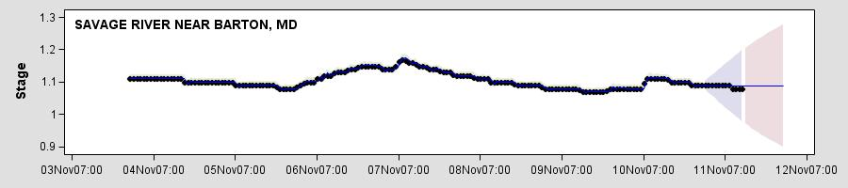
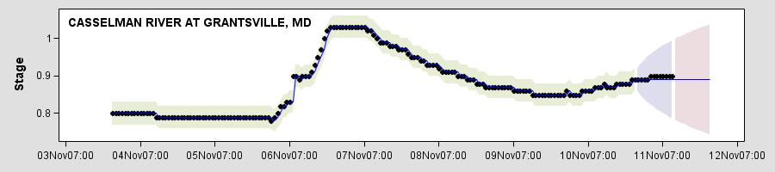
ODS Graphics Generated Graphs

Slide 34
Contact
Sam Croker
  scoyote@scoyote.net
www.sascommunity.org

